Slide 1

Sprocket Central Pty Ltd
Data analytics approach
[Division Name] - [Sanni Muhaemin], [Junior Consultant]

Slide 2
Note: The data and information in this document is reflective of a hypothetical situation and client. This document is to be used for KPMG Virtual Internship purposes only.
Agenda
Introduction
Data Exploration
Model Development
Interpretation

Slide 3
Introduction
SPRocket central Pty Development Roadmap
Data Exploration
Unveil useful trends that can lead to hypothesis against which we can test.
Data Modeling
A model employs iteration. Each model is built and tested and based on the previous one until a fitting model for the desired criteria is achieved.
Data Interpretation
Data is evaluated using several test metrics and visualized as a dashboard so the marketing team can map out business strategies.

Slide 4
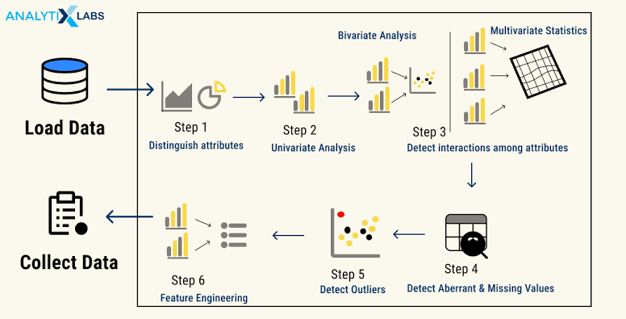
Data Exploration
Data exploration, also called exploratory data Analysis (EDA) is the initial step in data analysis used to explore and visualize data to uncover insights from the start or patterns to dig deeper.
BENEFITS:
Helps to know the sufficiency of the dataset to achieve project goals and which variables can not be used
Reduces the risk of imbalance distribution of the dataset by checking the skewness of a particular field.
Removes the redundant values from the dataset by treating missing values and outliers.
Able to check overfitting problem which usually results out of high Correlation between multiple variables and can be checked using correlation analysis.
Place any supporting images, graphs, data or extra text here.

Slide 5
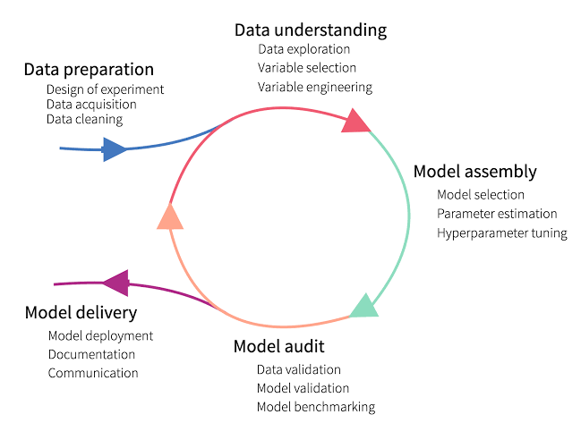
Model Development
Model development is an iterative process, in which many models are derived, tested and built upon until a model fitting the desired criteria is built.
The Initial step is to determine a hypothesis questioning the problem statement and then perform statistical testing to determine if the hypothesis is valid or not.
Then evaluate the performance of the models using factors such as ROC Curves, Precision, Recall, AUC Curve, Accuracy, F1-score etc.
Finally, deploy and document the best model’s performance, assumptions and certain limitations.
Place any supporting images, graphs, data or extra text here.

Slide 6
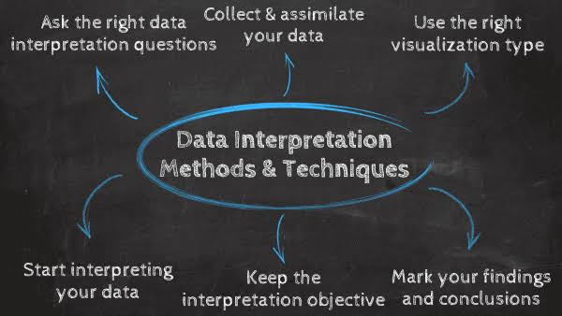
Interpretation
Data interpretation is the final step of data analysis where we turn results into a presentable format to gain clear and useful insights for business strategies.
Quantitative and qualitative methods are distinct types of data analyses both offering different type of data interpretation & decision making abilities.
Data dashboards decentralize data without compromising on the necessary speed of thought while blending both quantitative and qualitative data.
We will give reports on the insightful findings in the form of a dashboard which will demonstrate the Customer Demographic , Target Customers, Top Selling Goods etc. to help the team to make appropriate business decisions.

Slide 7
Thanks for your Attention

